Slide 1
Measurement and Fitting of Microwave Resonators
2/08/2019
Moe Khalil
Distribution Statement A: Approved for Unlimited Release; #19-0149; Dated 02/08/19

Slide 2
Outline
Two-level system (TLS) defects
Measurement apparatus
Resonator circuit analysis
Modeling and accounting for asymmetric (Fano) resonance line shapes
Optimizing measurement point spacing
Distribution Statement A: Approved for Unlimited Release; #19-0149; Dated 02/08/19

Slide 3
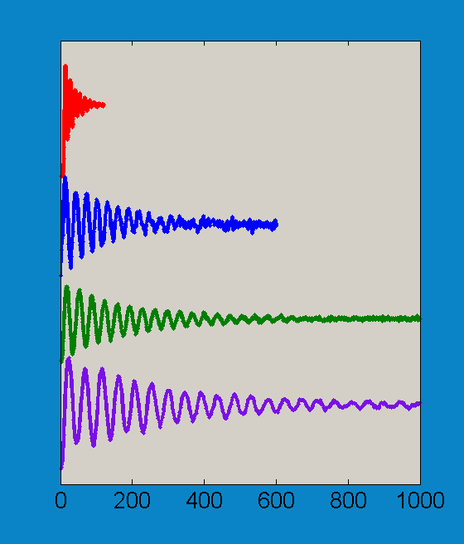
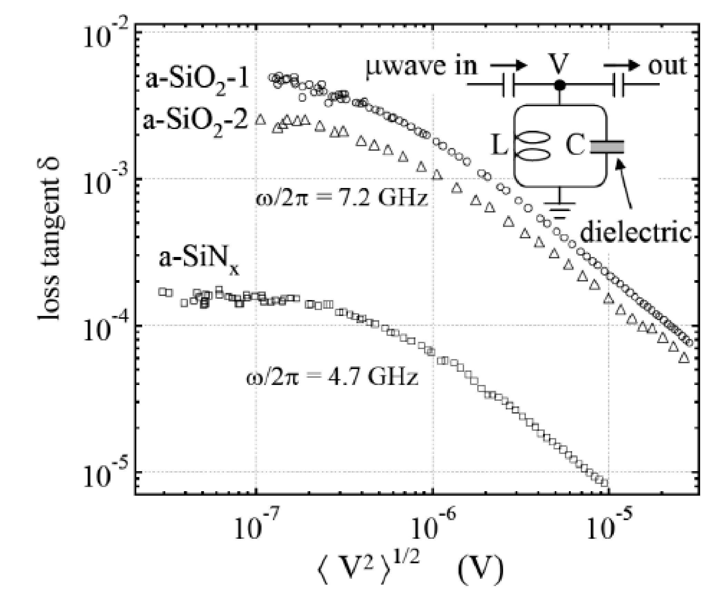
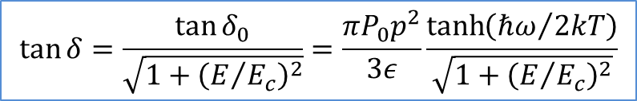
Resonators are Useful for Qubit Diagnosis
LC Resonator Power Sweep
Improved Rabi Oscillations
Dielectric Loss (δ=1/Q₀)
Qubit Rabi Oscillations
Large C_{stray} , SiO₂
Small C_{stray} , SiO₂
Small C_{stray} , SiN_{x} 1
Small C_{stray} , SiN_{x} 2
Bosonic Modes
$$\tan{δ=\frac{\tan{δ_{0}}}{\sqrt{1+{\left(E/{E_{c}}\right)}^{2}}}=\frac{πP_{0}p^{2}}{3ε}\frac{\tanh\left({ℏω}/{2kT}\right)}{\sqrt{1+{\left(E/{E_{c}}\right)}^{2}}}}$$
Time (ns)
Time (ns)
Dielectric Loss Causes Decoherence
Martinis et al. PRL 95, 210503 (2005)
Distribution Statement A: Approved for Unlimited Release; #19-0149; Dated 02/08/19
Notes:
So what we have here is a resonator measurement on the left with the loss tangent as a function of the voltage across the resonator, and these are the same Rabi oscillations I showed earlier but I’ve labeled the different materials used for each of them. I’ll talk about how these resonator measurements are done in a minute and I’ll talk about the functional form of this loss tangent and why it looks like this a little bit later. But basically what you wanna take out of this is that SiO_2 which is making qubits with short Rabi oscillations also shows high resonator loss and SiNx which is making qubits with longer Rabi oscillations shows lower loss when you put it in a resonator. So we don’t need to make qubits to optimize our materials, we can just make resonators.
And as you can see from the resonator measurements the SiNx which showed longer coherence times in the qubit shows lower dielectric loss. I’ll go over how this measurement is done later but for now lets focus on the functional form of this loss. So what’s happening is that this loss is caused by TLS defects coupling to the electric field of our device and taking energy from it so it’s causing loss. At low resonator voltage these TLSs are all in their ground state so any energy that gets added to the resonator they’ll take, but as the voltage increases it’s becoming more and more likely that they’re in their excited state so at that point they’re just as likely to emit energy as absorb it, so they start to contribute less to loss.

Slide 4
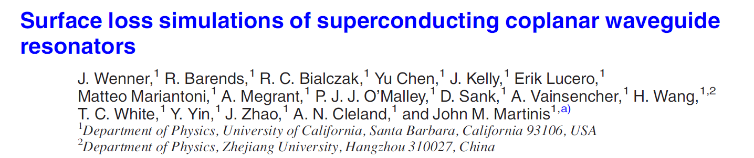
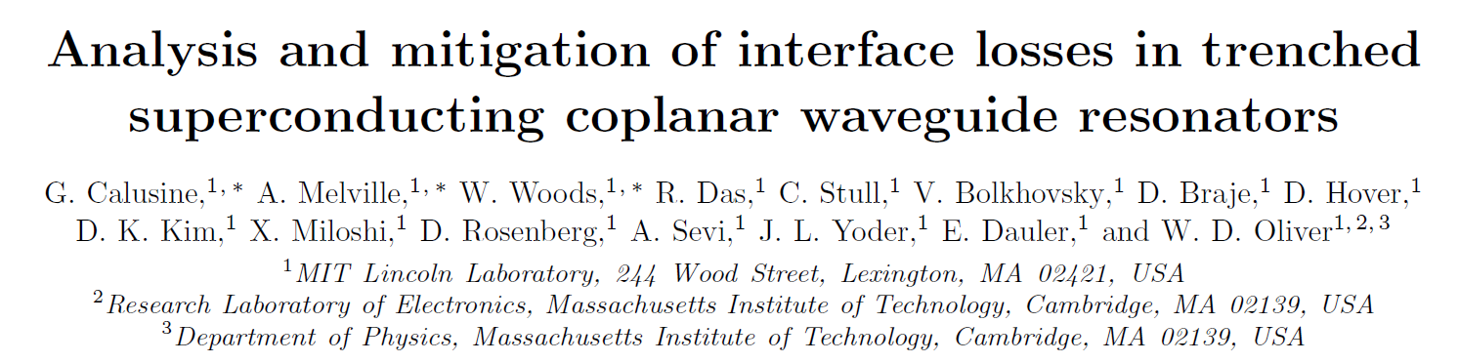
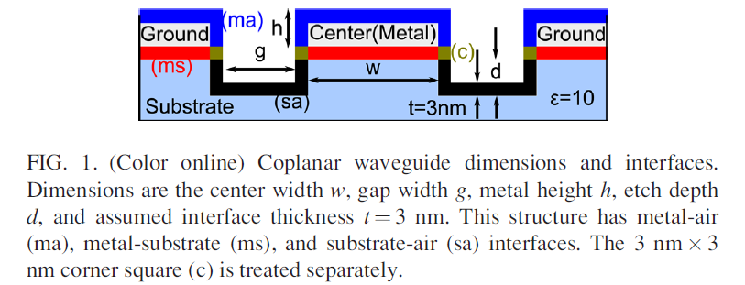
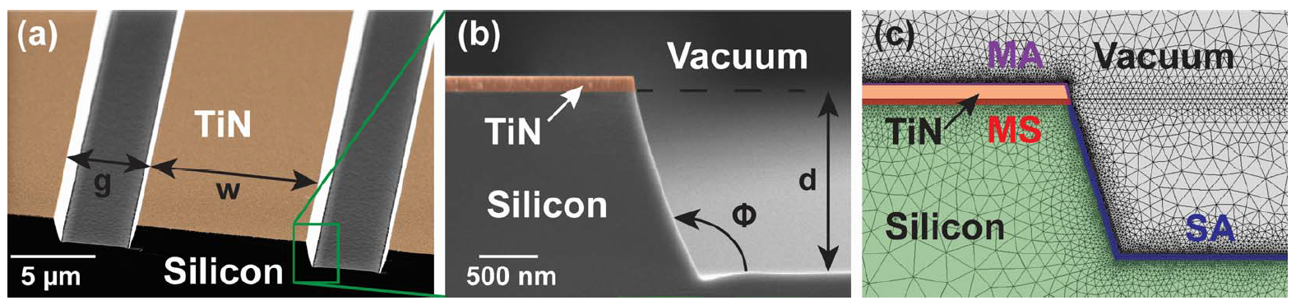
Resonators are also Used to Optimize Surface Loss in Coplanar Devices
Key Developments:
Contributed to X-mon qubit design
First major published study of loss at circuit interfaces
Key Developments:
First successful loss matrix inversion experiment
Silicon Q measured to be ~ 4 million
Distribution Statement A: Approved for Unlimited Release; #19-0149; Dated 02/08/19

Slide 5
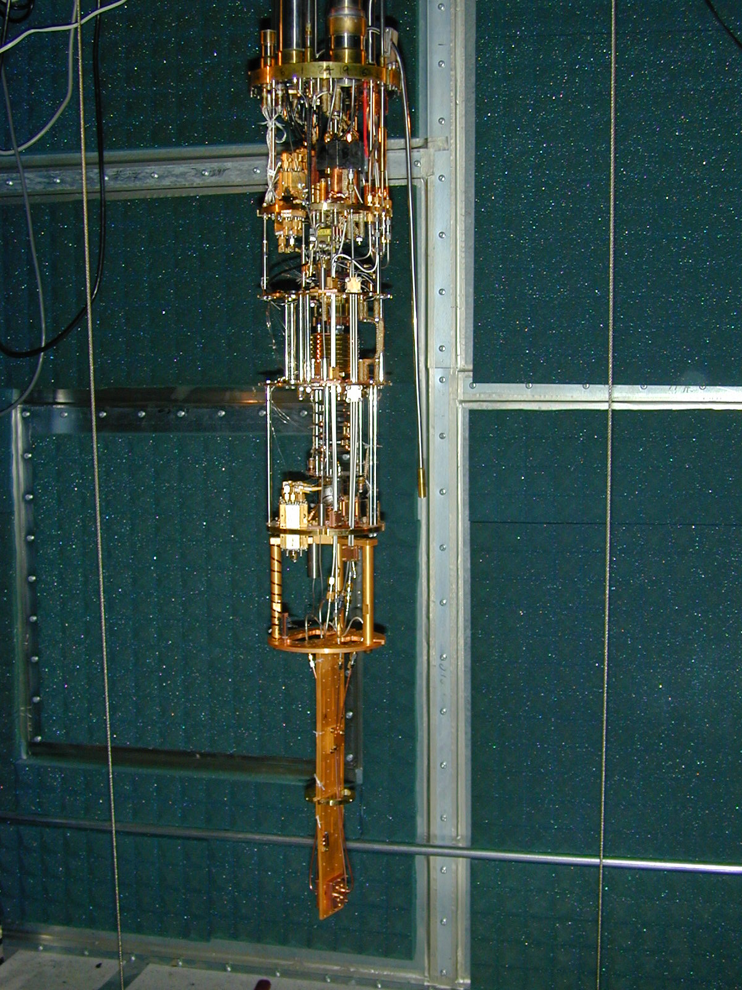
Measurement Apparatus
Dilution Refrigerator
Transmission Measurement (bias lines not shown)
Network Analyzer
V_{source}
V_{measure}
300K
-20 dB
3 K
-20 dB
Z₀
800 mK
-10 dB
20 mK
2X
-30 dB
Z₀
Device
V_{in}
V_{out}
Distribution Statement A: Approved for Unlimited Release; #19-0149; Dated 02/08/19
Notes:
So here’s the setup for our measurement. The device goes at the bottom of a dilution refrigerator which cools it down to 30mK. And we’ve got microwave cables going down with attenuators to beat down any thermal 300K noise as well as a cryogenic LNA on the output and some room temperature amplification. We’ve also got these circulators to keep reflections from the amplifiers from going back to our device and to help thermalize the center conductor of the microwave line. So basically we output a signal from the Network analyzed, it goes through the device and we measure the output to characterize the device. We basically have to measure it cold for two reasons,

Slide 6



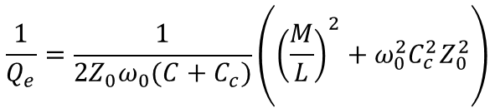

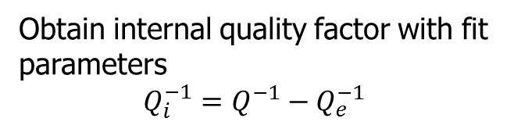
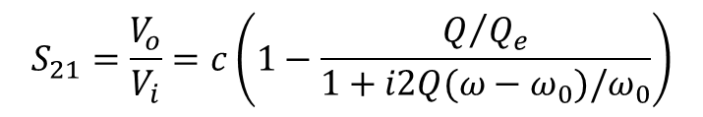
Resonator Circuit Analysis
Device
L₁
M
C_{C}
$$Z_{0}$$
L
$$Z_{0}$$
V
$$\frac{1}{Q_{e}}=\frac{1}{2Z_{0}ω_{0}(C+C_{c})}\left({\left(\frac{M}{L}\right)}^{2}+ω_{0}^{2}C_{c}^{2}Z_{0}^{2}\right)$$
Norton Equivalent
$$\frac{1}{Q_{e}}=\frac{ω_{0}^{2}}{2πk}\left(\frac{M^{2}}{Z_{R}Z_{0}}+Z_{0}Z_{R}C_{c}^{2}\right)$$
$$I_{N}$$
L
C_{T}
R_{T}
V
Resonance Lineshape
Obtain internal quality factor with fit parameters
$$Q_{i}^{−1}=Q^{−1}−Q_{e}^{−1}$$
$$S_{21}=\frac{V_{o}}{V_{i}}=c\left(1−\frac{Q/{Q_{e}}}{1+i2Q(ω−ω_{0})/ω_{0}}\right)$$
Distribution Statement A: Approved for Unlimited Release; #19-0149; Dated 02/08/19
Khalil, et. al., JAP 111, 054510 (2012)
Notes:
So here’s a schematic of the measurement setup. You’ve got an LC resonator coupled in general both inductively and capacitively to a CPW. You put in a signal and on resonance it couples to the resonator so you get less on the output. You can solve Kirkove’s equations for this circuit and get an S21 measurement for the output as a function of the resonator quality.

Slide 7
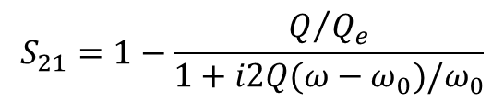
Transmission Measurement
Amplitude of Signal
$$S_{21}=1−\frac{Q/{Q_{e}}}{1+i2Q(ω−ω_{0})/ω_{0}}$$
Distribution Statement A: Approved for Unlimited Release; #19-0149; Dated 02/08/19
Notes:
The best way to understand what that means is by breaking the signal up into its components. You look at the amplitude of the signal you get a Lorentzian

Slide 8
Transmission Measurement
Amplitude of Signal
I/Q Components of Signal
$$S_{21}=1−\frac{Q/{Q_{e}}}{1+i2Q(ω−ω_{0})/ω_{0}}$$
Distribution Statement A: Approved for Unlimited Release; #19-0149; Dated 02/08/19
Notes:
but if you break it up into its real and imaginary components you get a circle. Where this is off resonance and this is on resonance.

Slide 9
Transmission Measurement
Amplitude of Signal
I/Q Components of Signal
$$S_{21}=1−\frac{Q/{Q_{e}}}{1+i2Q(ω−ω_{0})/ω_{0}}$$
Distribution Statement A: Approved for Unlimited Release; #19-0149; Dated 02/08/19
Notes:
Let me show that more explicitly

Slide 10
Transmission Measurement
Amplitude of Signal
I/Q Components of Signal
$$S_{21}=1−\frac{Q/{Q_{e}}}{1+i2Q(ω−ω_{0})/ω_{0}}$$
Distribution Statement A: Approved for Unlimited Release; #19-0149; Dated 02/08/19
Notes:
Let me show that more explicitly

Slide 11
Transmission Measurement
Amplitude of Signal
I/Q Components of Signal
$$S_{21}=1−\frac{Q/{Q_{e}}}{1+i2Q(ω−ω_{0})/ω_{0}}$$
Distribution Statement A: Approved for Unlimited Release; #19-0149; Dated 02/08/19
Notes:
Let me show that more explicitly

Slide 12
Transmission Measurement
Amplitude of Signal
I/Q Components of Signal
$$S_{21}=1−\frac{Q/{Q_{e}}}{1+i2Q(ω−ω_{0})/ω_{0}}$$
Distribution Statement A: Approved for Unlimited Release; #19-0149; Dated 02/08/19
Notes:
Let me show that more explicitly

Slide 13
Transmission Measurement
Amplitude of Signal
I/Q Components of Signal
$$S_{21}=1−\frac{Q/{Q_{e}}}{1+i2Q(ω−ω_{0})/ω_{0}}$$
Distribution Statement A: Approved for Unlimited Release; #19-0149; Dated 02/08/19
Notes:
Let me show that more explicitly

Slide 14
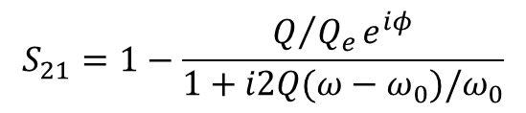
Transmission Measurement
Amplitude of Signal
I/Q Components of Signal
$$S_{21}=1−\frac{Q/{Q_{e}}e^{iφ}}{1+i2Q(ω−ω_{0})/ω_{0}}$$
Distribution Statement A: Approved for Unlimited Release; #19-0149; Dated 02/08/19
Notes:
So this asymmetry effectively looks like a rotation around the off resonance point on the circle. So this phase shift people were adding is a natural thing to assume if you don’t know where the asymmetry comes from.

Slide 15
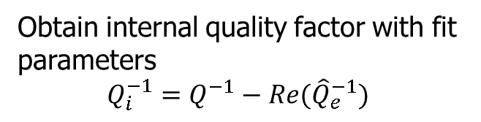





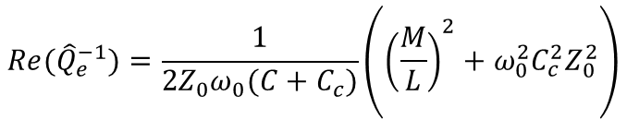
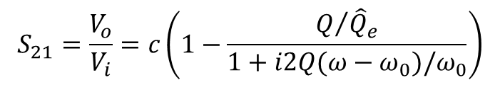
Resonator Circuit Analysis
Device
L₁
M
C_{C}
$$Z_{a}$$
L
$$Z_{b}$$
V
$$Re({\hat{Q}}_{e}^{−1})=\frac{1}{2Z_{0}ω_{0}(C+C_{c})}\left({\left(\frac{M}{L}\right)}^{2}+ω_{0}^{2}C_{c}^{2}Z_{0}^{2}\right)$$
Norton Equivalent
$$Re({\hat{Q}}_{e}^{−1})=\frac{ω_{0}^{2}}{2πk}\left(\frac{M^{2}}{Z_{R}Z_{0}}+Z_{0}Z_{R}C_{c}^{2}\right)$$
$${\hat{I}}_{N}$$
L
C_{T}
R_{T}
$$G_{D}$$
V
Resonance Lineshape
Obtain internal quality factor with fit parameters
$$Q_{i}^{−1}=Q^{−1}−Re({\hat{Q}}_{e}^{−1})$$
$$S_{21}=\frac{V_{o}}{V_{i}}=c\left(1−\frac{Q/{{\hat{Q}}_{e}}}{1+i2Q(ω−ω_{0})/ω_{0}}\right)$$
Distribution Statement A: Approved for Unlimited Release; #19-0149; Dated 02/08/19
Khalil, et. al., JAP 111, 054510 (2012)
Notes:
So here’s a schematic of the measurement setup. You’ve got an LC resonator coupled in general both inductively and capacitively to a CPW. You put in a signal and on resonance it couples to the resonator so you get less on the output. You can solve Kirkove’s equations for this circuit and get an S21 measurement for the output as a function of the resonator quality.

Slide 16
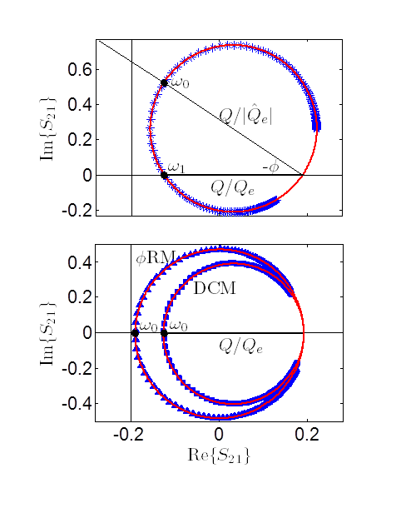
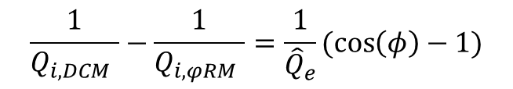
Diameter Correction Analysis Method
Simulated Data
Comparison of 2 analysis techniques
Discrepancy:
$$\frac{1}{Q_{i, DCM }}−\frac{1}{Q_{i, φRM }}=\frac{1}{{\hat{Q}}_{e}}(cos\left(φ\right)−1)$$
Distribution Statement A: Approved for Unlimited Release; #19-0149; Dated 02/08/19
Khalil, et. al., JAP 111, 054510 (2012)
Notes:
But in fact if you work it out the asymmetry in addition to rotating the circle grows it so that if you just rotate it back, you end up overestimating the diameter. The quantity that needs to be conserved in this transformation isn’t the diameter of the circle but rather the real axis segment intersecting the circle.

Slide 17
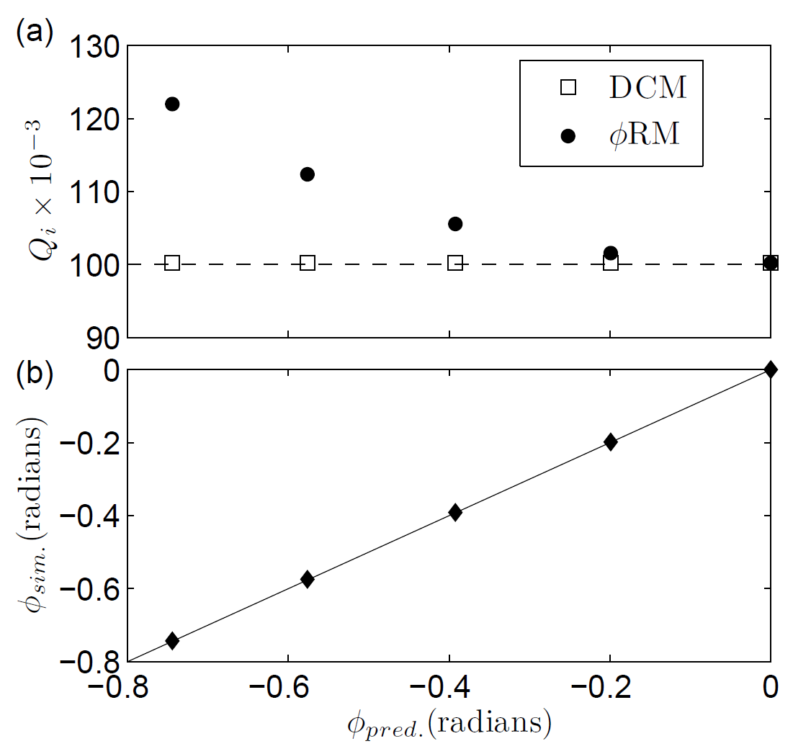
Diameter Correction Analysis Method
Simulated Data
Comparison of 2 analysis techniques
Discrepancy:
$$\frac{1}{Q_{i, DCM }}−\frac{1}{Q_{i, φRM }}=\frac{1}{{\hat{Q}}_{e}}(cos\left(φ\right)−1)$$
Distribution Statement A: Approved for Unlimited Release; #19-0149; Dated 02/08/19
Khalil, et. al., JAP 111, 054510 (2012)
Notes:
But in fact if you work it out the asymmetry in addition to rotating the circle grows it so that if you just rotate it back, you end up overestimating the diameter. The quantity that needs to be conserved in this transformation isn’t the diameter of the circle but rather the real axis segment intersecting the circle.

Slide 18
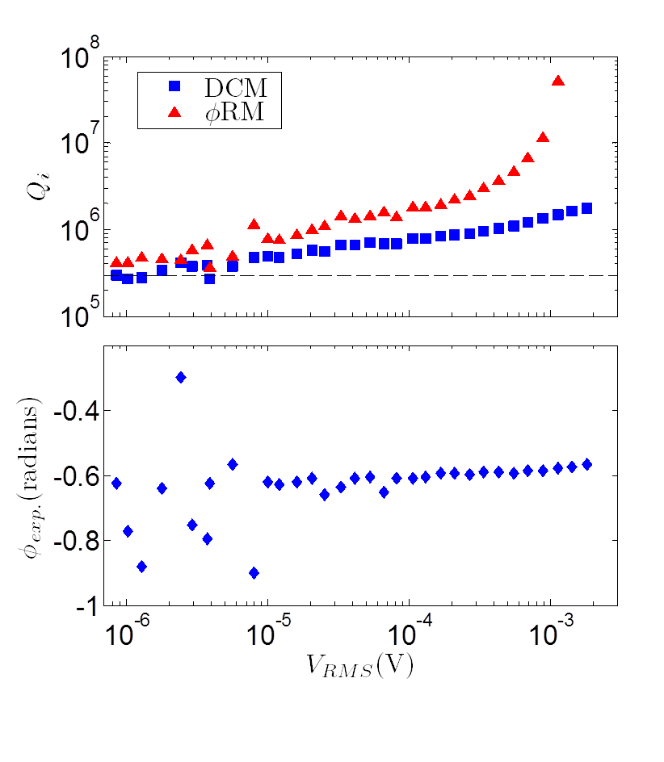
Diameter Correction Analysis Method
Simulated Data
Comparing techniques for asymmetric data
Comparison of 2 analysis techniques
Discrepancy:
$$\frac{1}{Q_{i, DCM }}−\frac{1}{Q_{i, φRM }}=\frac{1}{{\hat{Q}}_{e}}(cos\left(φ\right)−1)$$
Distribution Statement A: Approved for Unlimited Release; #19-0149; Dated 02/08/19
Khalil, et. al., JAP 111, 054510 (2012)
Notes:
So this can make a pretty big different if the asymmetry is large enough, especially if the coupling is higher the internal quality of the resonator. This was a simulation to show the effect, and this is real data showing how different the extracted quality of the resonator can be if you’re not careful about how you do this rotation. This axis is the voltage across the resonator and this is the extracted internal quality factor using the two methods. The rotation method systematically over estimates the quality of the resonator but it’s completely deterministic so if you analyze your data with this rotation and you keep track of the rotation angle phi you can work back to what the real internal quality factor should be.

Slide 19
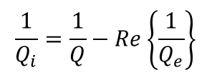
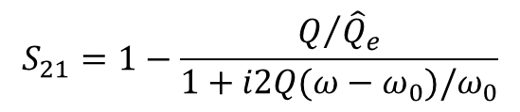




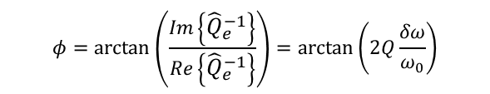



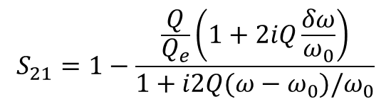
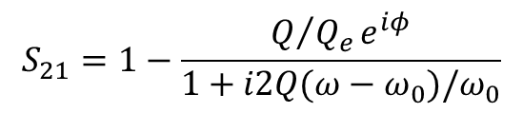



Various Techniques to Model and Parametrize Asymmetry
L₁
$$S_{21}=1−\frac{Q/{Q_{e}}e^{iφ}}{1+i2Q(ω−ω_{0})/ω_{0}}$$
C_{C}
$$\frac{1}{Q_{i}}=\frac{1}{Q}−\frac{1}{Q_{e}}\cos{φ}$$
M
$$Z_{b}$$
L
$$Z_{a}$$
V
Correct $φ$rotation method
$$S_{21}=1−\frac{Q/{{\hat{Q}}_{e}}}{1+i2Q(ω−ω_{0})/ω_{0}}$$
$$\frac{1}{Q_{i}}=\frac{1}{Q}−Re\left\{\frac{1}{Q_{e}}\right\}$$
L₁
L_{W}
Khalil, et. al., JAP 111, 054510 (2012)
M
C_{C}
$$S_{21}=1−\frac{\frac{Q}{Q_{e}}\left(1+2iQ\frac{δω}{ω_{0}}\right)}{1+i2Q(ω−ω_{0})/ω_{0}}$$
$$Z_{0}$$
L
$$Z_{0}$$
$$\frac{1}{Q_{i}}=\frac{1}{Q}−\frac{1}{Q_{e}}$$
V
Geerlings, et. al., APL 100, 192601 (2012)
$$φ=\arctan\left(\frac{Im\left\{{\hat{Q}}_{e}^{−1}\right\}}{Re\left\{{\hat{Q}}_{e}^{−1}\right\}}\right)=\arctan\left(2Q\frac{δω}{ω_{0}}\right)$$
$$Z_{L}$$
L₁
M
C_{C}
If you derive your own version you should simulate data with asymmetry and fit it to ensure you’re extracting the correct quality factor
$$Z_{0}$$
L
$$Z_{0}$$
V
Distribution Statement A: Approved for Unlimited Release; #19-0149; Dated 02/08/19

Slide 20
Taking Data as Efficiently as Possible
Taking data uses resources and has a real cost
There’s a tradeoff between optimizing time and accuracy
Often it is more efficient to measure multiple devices and acquire statistics than to measure fewer devices more accurately
One approach is to establish the desired error in the measurement and then minimize the time it takes to achieve that error
Optimizing frequency spacing of data points is useful in that respect
|S21|
Data
Fit
f(GHz)
Real measurements are noisy and require averaging. There’s no reason to spend as much time taking data at the edge of the resonator as in the middle
Distribution Statement A: Approved for Unlimited Release; #19-0149; Dated 02/08/19

Slide 21
Procedure to Optimize Frequency Points
Block diagram:
Generate initial point distribution from a large set of candidate points
Distribution Statement A: Approved for Unlimited Release; #19-0149; Dated 02/08/19

Slide 22
Procedure to Optimize Frequency Points
Block diagram:
Generate initial point distribution from a large set of candidate points
Adjust one point one step
Distribution Statement A: Approved for Unlimited Release; #19-0149; Dated 02/08/19

Slide 23

Procedure to Optimize Frequency Points
Block diagram:
Generate initial point distribution from a large set of candidate points
Adjust one point one step
Calculate new figure of merit
Figure of merit: $ℱ={σ_{β}^{2}}/{σ^{2}}$
Distribution Statement A: Approved for Unlimited Release; #19-0149; Dated 02/08/19

Slide 24
Procedure to Optimize Frequency Points
Block diagram:
Generate initial point distribution from a large set of candidate points
Adjust one point one step
Calculate new figure of merit
If figure of merit is better keep change, otherwise discard
Figure of merit: $ℱ={σ_{β}^{2}}/{σ^{2}}$
Distribution Statement A: Approved for Unlimited Release; #19-0149; Dated 02/08/19

Slide 25
Procedure to Optimize Frequency Points
Block diagram:
Generate initial point distribution from a large set of candidate points
Adjust one point one step
Calculate new figure of merit
If figure of merit is better keep change, otherwise discard
If all points have been tested and no improvement detected, exit
Final Point Distribution
Figure of merit: $ℱ={σ_{β}^{2}}/{σ^{2}}$
Distribution Statement A: Approved for Unlimited Release; #19-0149; Dated 02/08/19

Slide 26


The Second Derivative is a Good Proxy for Optimizing Point Spacing
Improvement: 25.6%
Improvement: 49.0%
Consistent, significant improvement calculated
Magnitude of improvement depends on $Q_{i}/Q_{e}$ ratio
Distribution Statement A: Approved for Unlimited Release; #19-0149; Dated 02/08/19

Slide 27

Improvement Verified Experimentally
Linear parameters:
Mean: 6.0622e6
Variance: 1.215e12
Std: 1.1021e6
Mean of variance
estimates: 3.027e12
Variance from
mean parameters: 2.348e12
Second Derivative parameters:
Mean: 6.2648e6
Variance: 5.384e11
Std: 7.35254e5
Mean of variance
estimates: 8.117e11
Variance from
mean parameters: 3.853e11
Measured improvement: 55.5%
Estimated improvement for = 56, 3BW: 68.8%
Distribution Statement A: Approved for Unlimited Release; #19-0149; Dated 02/08/19

Slide 28
Improvement Verified Experimentally
Distribution Statement A: Approved for Unlimited Release; #19-0149; Dated 02/08/19

Slide 29
Improvement Verified Experimentally
Measured standard deviations qualitatively agree with theoretical predictions
Distribution Statement A: Approved for Unlimited Release; #19-0149; Dated 02/08/19

Slide 30
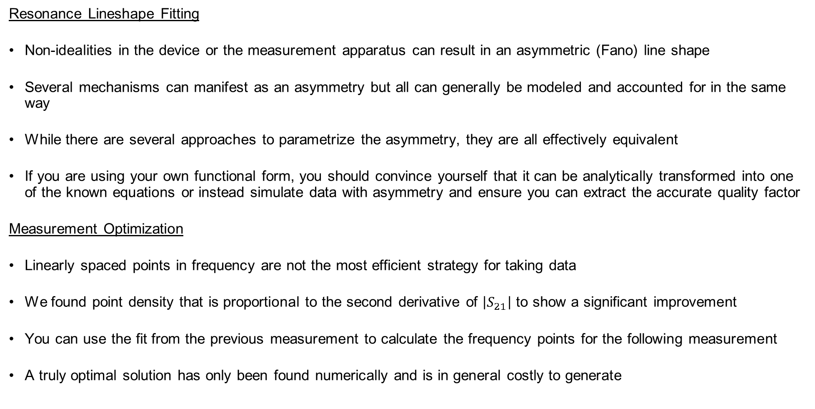
Conclusion
Resonance Lineshape Fitting
Non-idealities in the device or the measurement apparatus can result in an asymmetric (Fano) line shape
Several mechanisms can manifest as an asymmetry but all can generally be modeled and accounted for in the same way
While there are several approaches to parametrize the asymmetry, they are all effectively equivalent
If you are using your own functional form, you should convince yourself that it can be analytically transformed into one of the known equations or instead simulate data with asymmetry and ensure you can extract the accurate quality factor
Measurement Optimization
Linearly spaced points in frequency are not the most efficient strategy for taking data
We found point density that is proportional to the second derivative of $\left|S_{21}\right|$ to show a significant improvement
You can use the fit from the previous measurement to calculate the frequency points for the following measurement
A truly optimal solution has only been found numerically and is in general costly to generate
Distribution Statement A: Approved for Unlimited Release; #19-0149; Dated 02/08/19

